Slide 1
XPS Data 232nd Meeting of the Electrochemical Society Data Hack Day
NSWC Carderock: Christopher Hendricks, Azzam Mansour, Daphne Fuentevilla

Slide 2

X-Ray Photoelectron Spectroscopy
Vacuum chamber (~10⁻⁸ torr)
XPS is a surface analysis technique
Provides elemental and chemical state information
Combined with depth profiling (Argon/C60 sputtering) gives concentration as a function of depth from the surface
X-ray source
Electron detector
Incident x-rays
Ejected electrons
Sample
Known x-ray energy
Kinetic energy measured by detector
Notes:
XPS surface sensitive tool, uniquely suited to investigate SEI layer. Provides elemental and chemical state information of the SEI, active material, etc.
With current equipment, able to (when working) evaluate surface of material. New system will provide better spectral resolution –for example, what we think is happening at SEI, elemental/chemical state mapping, collect spectra with minimal exposure to Xrays which will reduce the damage to the chemical state of the surface. Unique sputtering of inorganic materials with minimal amount of radiation damage using C60 sputtering gun.
Carderock just invested in a brand new system with higher resolution and higher fidelity results

Slide 3
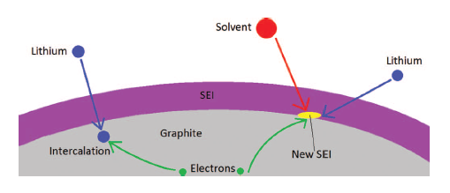
SEI Layer Investigation
Studying the SEI layer requires careful sample handling in a glove box environment.
M. Pinson and M. Bazant, “Theory of SEI formation in rechargeable batteries: capacity fade, accelerated aging, and lifetime prediction,” J. Electrochem Soc., 160 (2) (2013) pp. A243-A250.
It is believed to consist of a variety of insoluble species formed through reactions of the lithium salt, electrolyte, and graphite.
E.g., Li₂CO₃, LiF, Alkyl-carbonates
Can look at C1s, F1s, and O1s peaks to confirm that there is sufficient Carbon, Fluorine, and Oxygen for the hypothesized SEI layer species.
Notes:
Care about SEI layer because of its critical role in terms of battery operation
Whether copper or not, if SEI layer problems, can impact both performance and safety
Little trickier b/c of how sensitive the SEI layer is, and how complicated (heterogenous, many compounds)
Several more factors that play into health of SEI layer when recharging/reusing

Slide 4
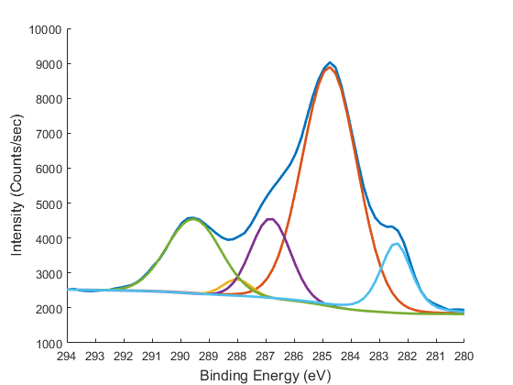
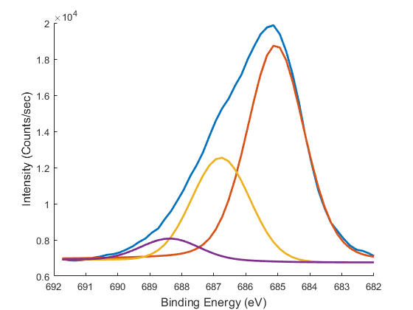
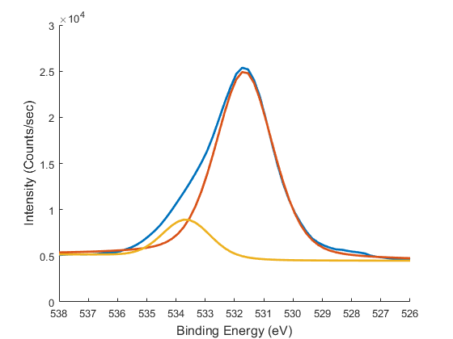
2.5 Volt Anode, Exterior
C1s
F1s
16.9% of total Carbon in CO₃
65.9% of total Fluorine in LiF
O1s
Perform non-linear curve fitting to de-convolute spectra.
In conjunction with elemental atm%, can attribute peaks to chemical states.
88.3% of total Oxygen in CO₃

Slide 5
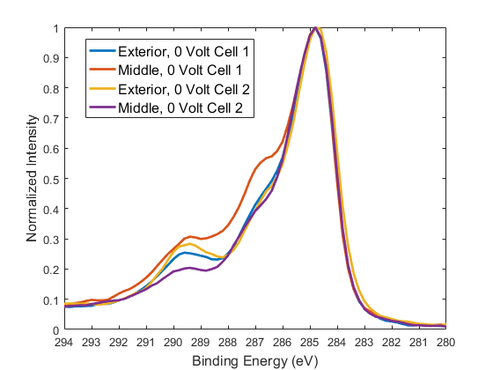
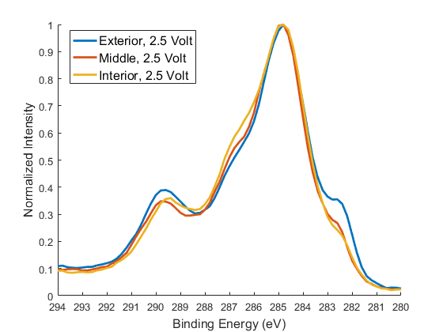
C1s Spectra
CO₃
CO₃
Intercalated graphite
2.5 V cell was not fully discharged and has an intercalated graphite peak around 282.5 eV.
Carbonate peaks occur around 290 eV and are the result of reactions between electrolyte solvents and lithium at the electrode surface.
Notes:
When we take into account total atomic percentage, all of the overdischarged cell samples had less carbonate

Slide 6
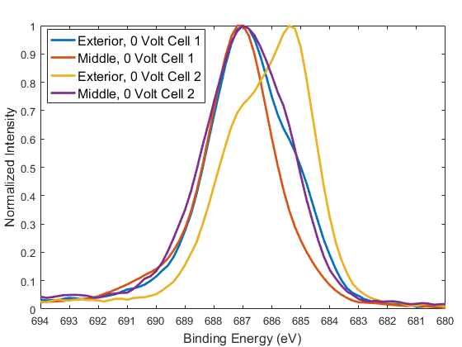
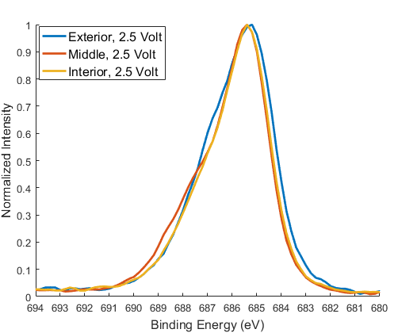
F1s Spectra
LiF
LiF
LiF has a F1s binding energy of 685 eV
Excess LiF is detrimental to battery performance (highly resistive) and could lead to loss of cyclable lithium
Notes:
When we take into account total atomic percentage, all of the overdischarged cell samples had less Lithium fluoride

Slide 7
Data Description
3 excel files have multiplex scans of anodes harvested from large-format lithium-ion cells.
C1s, F1s, and O1s spectra were obtained to look at possible changes to the SEI layer
One cell had been overdischarged to 0 Volts for an extended period of time
The other cell started at 3.4 V, was discharged to 2.5 V and disassembled.
Each file has 6 columns:
The first 3 columns belong to the 0 Volt cell
The next 3 columns belong to the 3.4 Volt cell
Column 1/3: Binding Energy (eV)
Column 2/5: Shifted binding energy to account for sample charging
Column 4/6: Signal intensity (counts/sec)
Notes:
When we take into account total atomic percentage, all of the overdischarged cell samples had less Lithium fluoride

Slide 8
References
Daphne Fuentevilla, Christopher Hendricks and Azzam Mansour, Quantifying the impact of overdischarge on large format lithium-ion cells, ECS Transactions Vol. 69 Issue 20 (2015) pp. 1-4
Christopher Hendricks, Azzam Mansour, and Daphne Fuentevilla, Failure mechanisms in overdischarged large-format lithium-ion cells, 47th Power Sources Conference, June 13, 2016.
Notes:
When we take into account total atomic percentage, all of the overdischarged cell samples had less Lithium fluoride

